Slide 1

Foul Mouths
Carly McKelvy
Patrick Leon
Justan Plumlee

Slide 2
Motivation & Summary
Core Message/Hypothesis
Do fouls have a significant impact the outcome of an NBA game?
Why do we ask?
Teams have used fouls to change the pace of a game.
Teams strategically setup poor free throw shooters to take free throws in hopes the opponent misses.
Do fouls have a significant impact on the game?
Let’s find out…

Slide 3
Questions and Data
Which referees call the most fouls, and are they biased against specific teams?
Are more fouls called against the Home or Away team?
When a team commits more fouls does it increase their chances of losing?
Are more fouls called in the later half of the season, after the All-Star break, as we approach playoffs?
Are more fouls called on a specific day of the week?
Do referees call more fouls based on region?

Slide 4
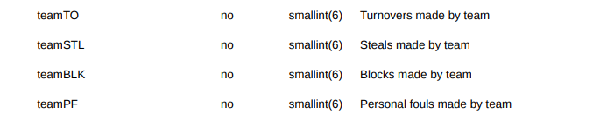
Data Clean up & Exploration
CSV
https://www.kaggle.com/pablote/nba-enhanced-stats
CSV contains regular season data for seasons between years 2012-2018
We explored each column to decide what was needed.
We utilized the metadata CSV to understand the calculations used and what the acronyms represented.
Does TO mean turnover or timeout?
What do columns PTS1, PTS2, PTS3, etc. represent?
Points are broken down by quarter but fouls, free throws, etc. are not.
No flagrant foul data
Data repeats for home and away team in columns and rows. Rows hold more data for each team.

Slide 5
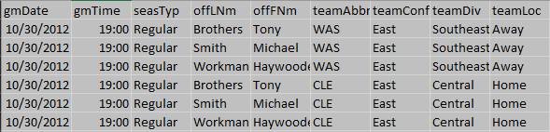
Data Cleanup cont.
Referee data
Referee foul counts are identical for each game meaning all 3 referees were credited for the total fouls of the game and not for fouls they personally called.
6 rows for each game, 2 for each referee involved.
Create new data frame
We created a sorted dataframe which removed duplicate rows for each game.
The date column needed to be formatted as a date and then converted to an epoch/Unix timestamp to create bins.

Slide 6
Data analysis
Our first approach was to analyze referees.
Referee data was not as robust as we initially thought.
Next, we decided to only look at exclusively fouls
Home/away teams
Time of year
Winning/losing teams
Day of the week
Region

Slide 7
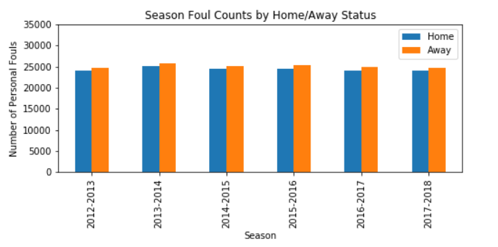
Are more fouls called against the Home or Away team?
On average home teams commit 19.8 fouls per game.
On average away teams commit 20.46 fouls per game.

Slide 8
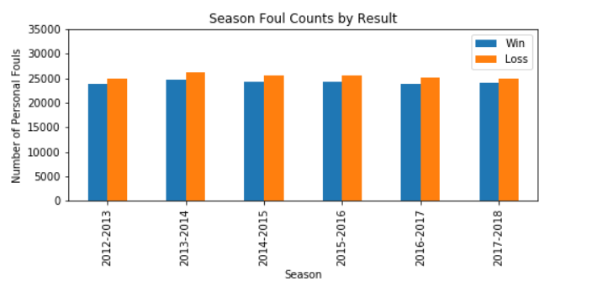
Does the losing team commit more fouls across the six seasons of data?
Losing teams commit on average 20.63 fouls overall while winning teams 19.63 fouls overall.
That’s only 1 more foul per game!

Slide 9
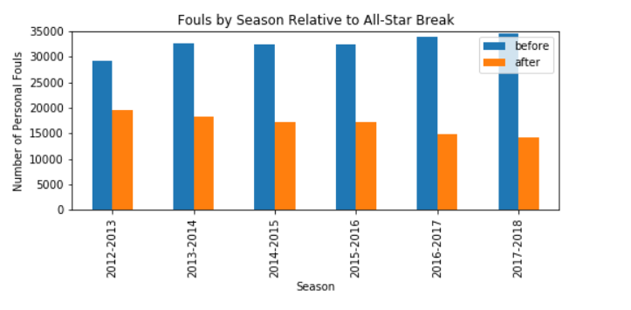
Are more fouls committed after All-Star break, as we get closer to playoffs?
All-Star break is near Valentine’s Day each year, which is close to 2/3 of the way through the season.
Number of games before All-Star break on average is 806.
Number of games after All-Star break on average is 424.
These numbers might look high, but in season 2012-2013 the total fouls committed in the regular season was 48,777!

Slide 10
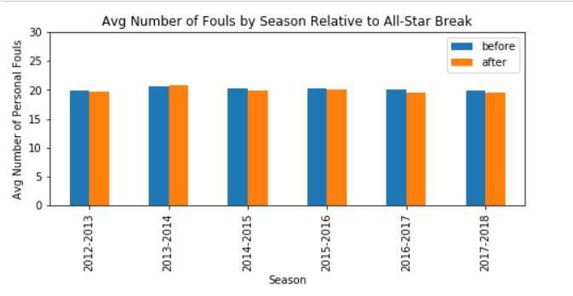
Are more fouls committed on average after All-Star break?
While All-Star break does represent a 2/3 point, and we know there are more games before, on average the number of fouls per game are very close.

Slide 11
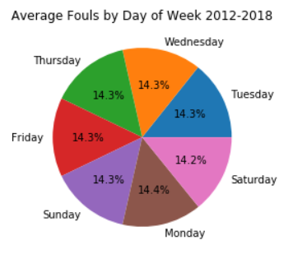
On average are more fouls committed on a specific day of the week?
While this could be an interesting statistic with individual referee data, the percentage of fouls based on the day of the week varied slightly.

Slide 12
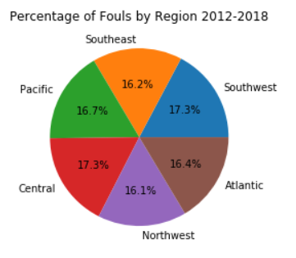
Are more fouls called in a specific region?
All regions are relatively close in overall percentage of fouls called.
Southwest and Central regions tie for highest percentage of regions.
Northwest has the lowest. (We’re just nicer people.)

Slide 13
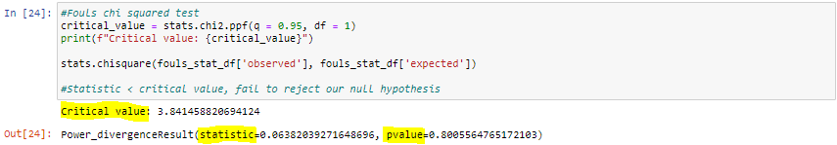
Statistical Analysis – Fouls vs Game Outcome
Since our critical value is greater than our statistic, the results of this test are not significant. We fail to reject our null hypothesis: that fouls do not have a significant impact the outcome of an NBA game.

Slide 14
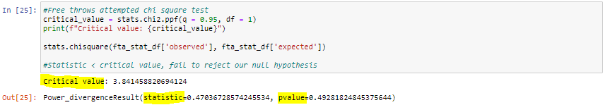
Free Throws Attempted vs Game Outcome
Once again, our critical value is greater than our statistic, so the results of this test are also not significant. Given that free throws attempted can still be missed, it would make sense that this statistic relates less directly to winning than just fouls. Let’s tackle this uncertainty and look at free throws made.

Slide 15
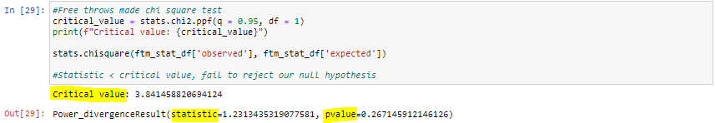
Free Throws Made vs Game Outcome
P-value represents the “evidence” against the null hypothesis.
Intuitively, fouls vs wins having the highest p-value makes sense in this context, since there are no guaranteed point associated with fouls.
Conversely, it makes sense that free throws made vs wins has the lowest p-value because that statistic has points associated with it, which directly contribute to winning a game.

Slide 16
Discussion
The losing team does commit more fouls, but not by much.
End of game fouling strategy might play into this trend.
Inversely winning teams will be shooting more free throws.
Less fouls are called after the All-Star break, but consistently on average for both teams.
Region does not play a huge factor in the number of fouls called.
Fouls across the for the entire league are surprisingly consistent regardless of regions, days of the week, home/away, and outcome.
Our initial questions were much more ambitious and could have delved further into some of these factors if more detailed game data had been available in our dataset.
It would be ideal to have a shooting-fouls-committed statistic to run a chi2 test on

Slide 17
Post Game Analysis
Difficulties
Converting our date column into a date data type, and then a Unix time stamp for binning our seasonal data so that we could divide it even further into before and after All-Star break.
Coming to terms with our data not being robust enough to take on the questions about specific referees.
Fouls not allocated by official who called the foul.
Additional Questions
Considering fouls often lead to free throw attempts does the percent made have a large impact on the outcome of the game?
Coaches always say defense wins game so does the team with the least turnovers or highest blocks have a significantly higher chance of winning?
Tracking the evolution of the NBA: charting the increase of 3-pointers attempted by year, as well as shooting percent on those attempts.

Slide 18
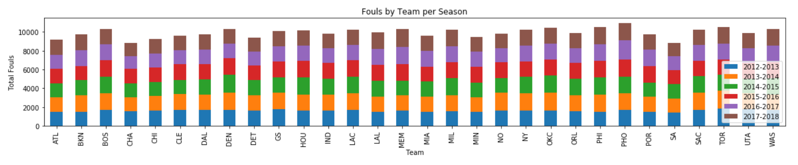
Questions?

